Slide 1

Real-Time Face Mask Detection using MobileNetV2
Presented By:
Eman Mahmoud Ibrahim
Sara Mahmoud Abd El-Aziz
Ibtehal Thabet Ahmed
Sohila Ahmed Mohamed
Supervisor:
Dr. Sameh Basha
Department of Mathematics
Faculty of Science
Cairo University

Slide 2
Outlines:
Problem Statement
Motivation
Introduction
Related Works
Description of dataset
Proposed Method
Results
Conclusions

Slide 3
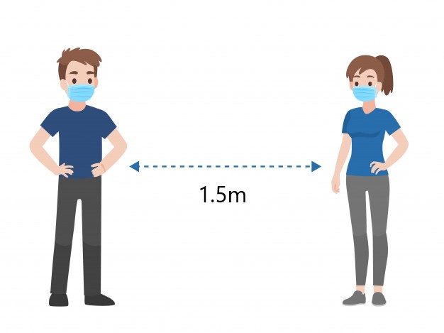
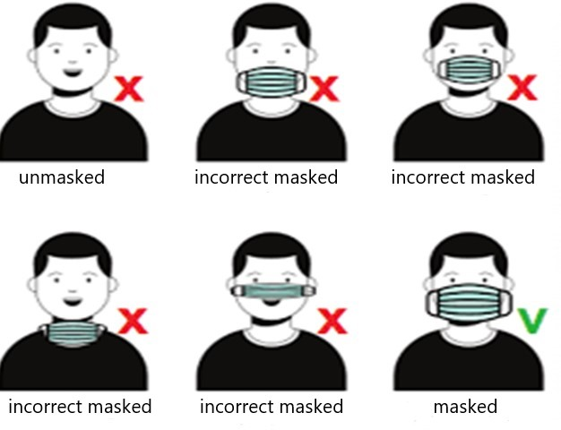
Problem Statement:
The model detect if the person wears his mask or not or wear it in wrong way and make sure that 1.5m at least around him empty.
The safe distance between people

Slide 4
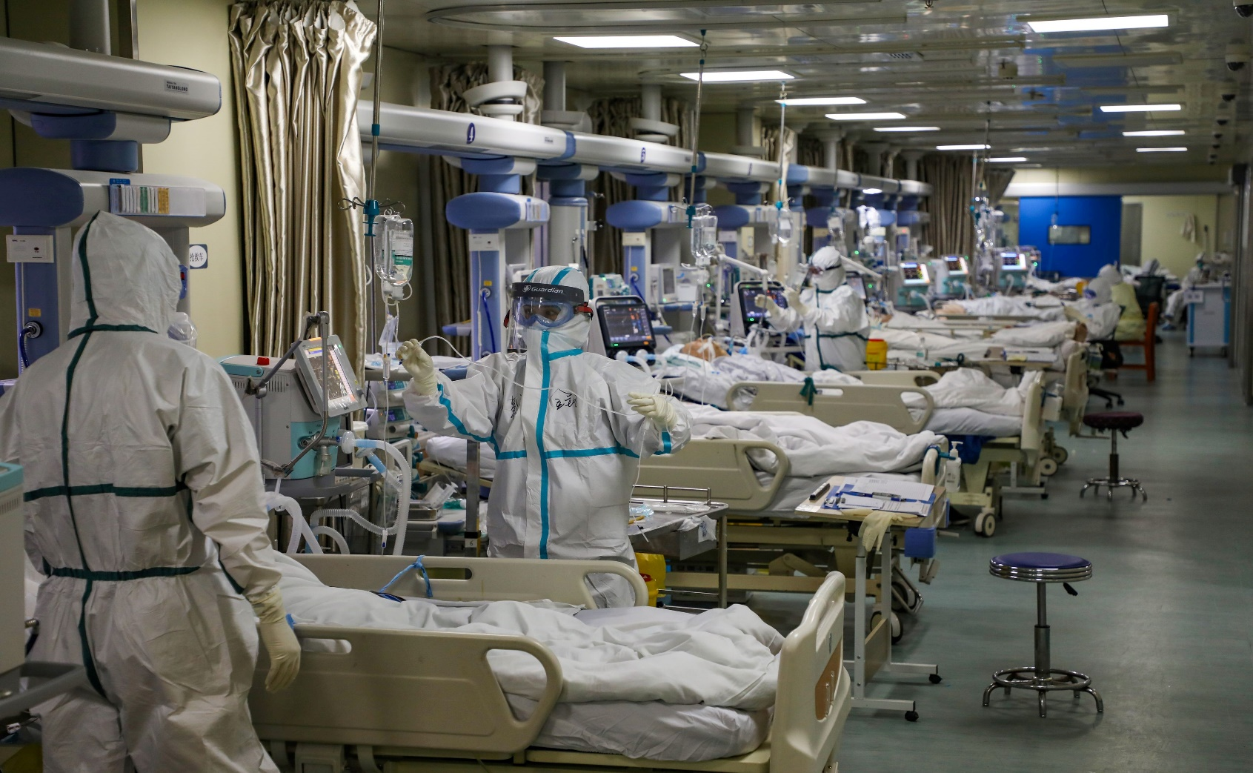
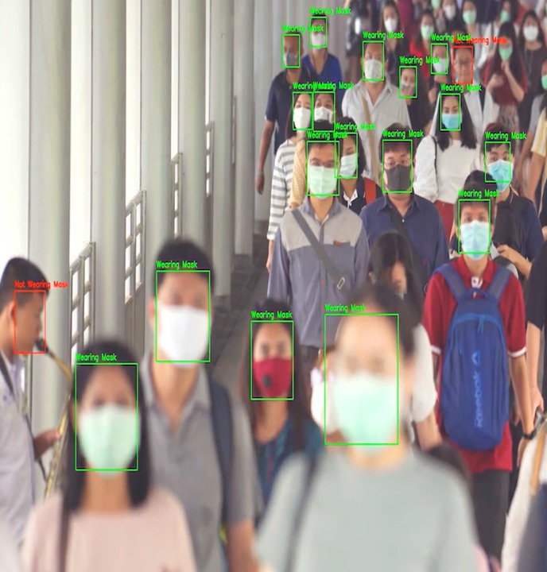
Motivation :
The most dangerous virus in the last interval is coronavirus COVID-19.
The number of injuries in the world due to COVID-19 until now about 180M and number of deaths about 3.9M.
The most effective way to limit spread of COVID-19 is wearing a mask in public areas and keep distance between people at least 1.5m.
This model can be used by the authorities to make reduction, evaluation, protection, and action planning against COVID-19.

Slide 5
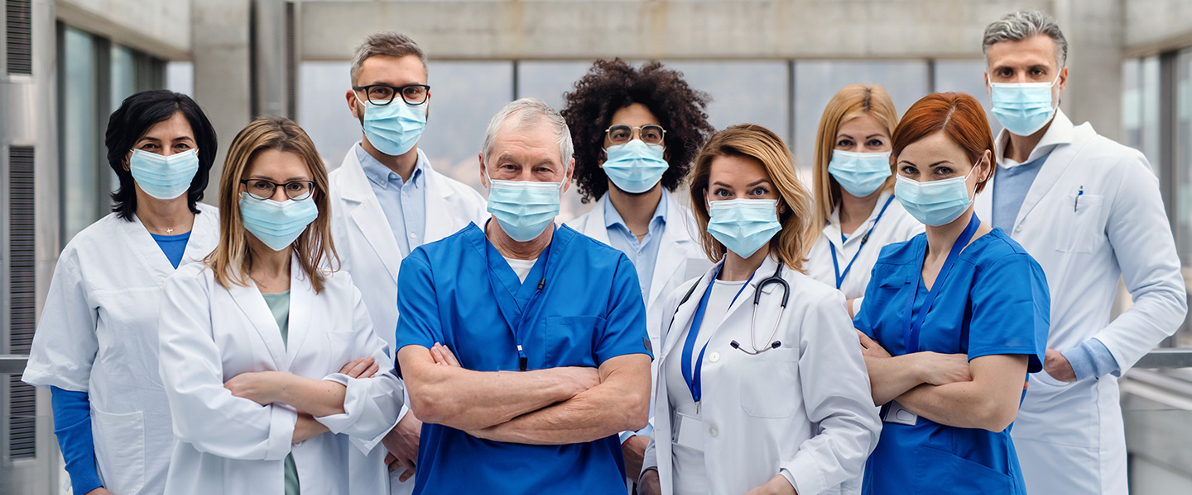
Introduction:
Several years ago, just doctors was use mask in hospitals and crowded places doesn't a big problem.
But now with the fast spread of COVID-19, all people should wear mask and keep distance between each other.
Artificial Intelligence (AI) based on Machine learning can help to fight Covid-19 in many ways.
Machine learning methods make better feature extraction and classification.
In this study, uses a machine learning algorithm through the image classification method: MobileNetV2, because it fast, has small size, and use small parameters.

Slide 6
Related Works:
Our focus is on classification people into to groups who and who are not wearing the face mask.
The table introduce some comparison between different approaches and their accuracy that have been used in other projects for face mask detection.

Slide 7
Related Works:
Name of paper, Date of publication | Approach | Accuracy
Face detection based on YOLOv3, 2020 | YOLOv3 | 93.9%
Comparative Study of Deep Learning Methods in Detection Face Mask Utilization, 2020 | MobileNetV2 | 93%
Comparative Study of Deep Learning Methods in Detection Face Mask Utilization, 2020 | ResNet50V2 | 99%
Comparative Study of Deep Learning Methods in Detection Face Mask Utilization, 2020 | Xception | 98%

Slide 8
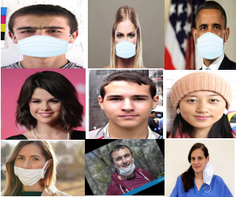
Description of dataset:
The dataset that used in this study from: ”https://www.kaggle.com/spandanpatnaik09/face-mask-detectormask-not-mask-incorrect-mask”
The data divided to with_mask, without_mask, incorrect_mask.
This study used 690 images for with mask, 686 images for without mask and 618 images for incorrect mask.
With mask
Without mask
Incorrect mask

Slide 9
Proposed Methods:
We used python with version 3.8 with Anaconda3 as editor.
The data was divided to 80% for training and 20% for validation.
The parameters was used in this study:
The augmentation.
The basic model that was used is MobileNetV2.
The top model used the layers: AveragePooling2D, Flatten, Dense, Dropout, Dense.
Fitting process with batch size 32.
Saving the model.
The Caffe model was used in the face recognition.

Slide 10
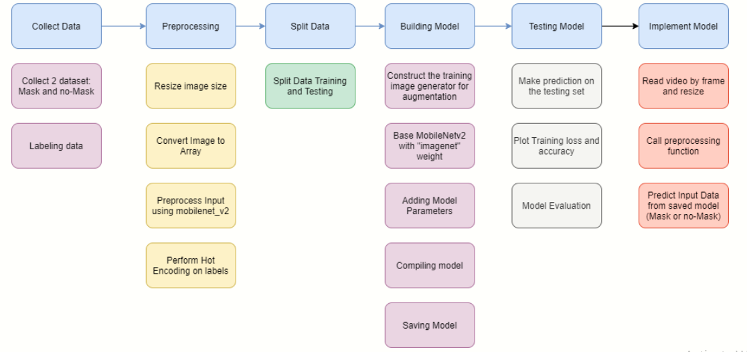

Slide 12
Results:
We have tested three models and the results show in the table below
According to these results the first model is the best.
Model | Testing/Training | Time(s) | Accuracy(%) | Loss(%) | Val_acc(%) | Val_loss(%)
1 | 20/80 | 1268 | 98.21 | 5.37 | 99.25 | 3.01
2 | 30/70 | 1627 | 98.39 | 5.58 | 98.66 | 4.35
3 | 35/65 | 1739 | 98.66 | 4.57 | 98.71 | 4.16

Slide 14
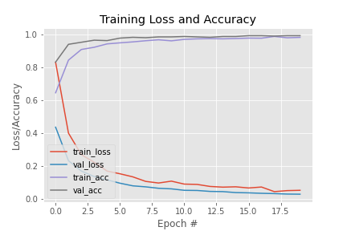
Results:
The accuracy after training and testing the model is 99% and the loss is 3% such that the accuracy increases from 83% to 99% as shown in graph
The graph of accuracy and loss

Slide 15
Results:
After saving the model, it implemented in the video.
When detecting the face from frames, reprocessing will happen as resizing the image, convert to array, and preprocessing input using MobileNetV2.
The model try to predict input data.
Now, it is easy to know if the person is wearing, not wearing, or wear incorrect the mask.

Slide 16
Conclusions:
The COVID-19 Epidemic is became a global health crisis.
There are a lot of people not wearing a mask or wear it wrong and close from each other, we need to detect that easy in public places like hospitals, Airports, clubs and moles
In this study, a model classifying people to: masked, unmasked and incorrect masked using MobileNetV2, give alert sound in the output when someone doesn't wear a mask or wear it in wrong way and make sure the distance between people is at least 1.5m.
The steps to build this model are: collecting the data, pre-processing, split the data, testing the model, and implement the model.

Slide 17
Questions?

Slide 18
Thanks a lot

